Slide 1
Impact of User Experience in Ranking of Restaurants
Andrew Wang

Slide 2
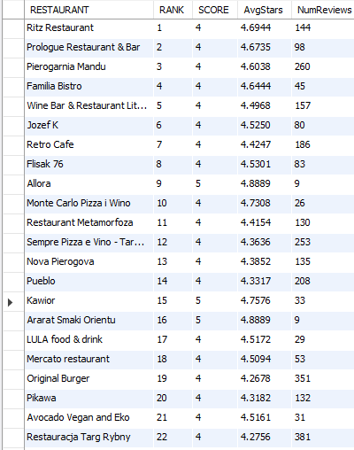
Ranking
select RESTAURANT, RANK, SCORE, avg(REVIEW_STARS) as AvgStars, count(REVIEW_STARS) as NumReviews from TRIPADVISOR group by RESTAURANT;
Average of REVIEW_STARS is a large factor, as is the number of reviews
SCORE is almost completely not a factor
Ranks 1-80 all have scores of 4 or 5 (7 in total have SCORE = 5)

Slide 3
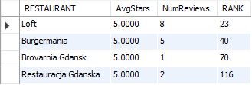
Perfect scores on Reviews, variations
Ranking SHOULD be affected by the number of reviews
Brovarnia Gdansk vs Restauracja Gdanska:
Difference of 1 review, yet 46 rank difference?
select RESTAURANT, avg(REVIEW_STARS) as AvgStars, count(REVIEW_STARS) as NumReviews, RANK from TRIPADVISOR group by RESTAURANT having AvgStars = 5;

Slide 4
Brovarnia vs Restauracja in depth
Possible factors to ranking:
SCORE
Ratio of helpful votes (Most likely factor):
Brovarnia: 61.5%
Restauracja: 35.12%
While we’re at it:
Loft: 38.27%, SCORE = 5, 162 total reviews
Burgermania: 46.15%, SCORE = 5, 13 total reviews
Recency of review dates
select * from TRIPADVISOR where RESTAURANT = 'Brovarnia Gdansk' or RESTAURANT = 'Restauracja Gdanska' or RESTAURANT = 'Loft' or RESTAURANT = 'Burgermania';

Slide 5

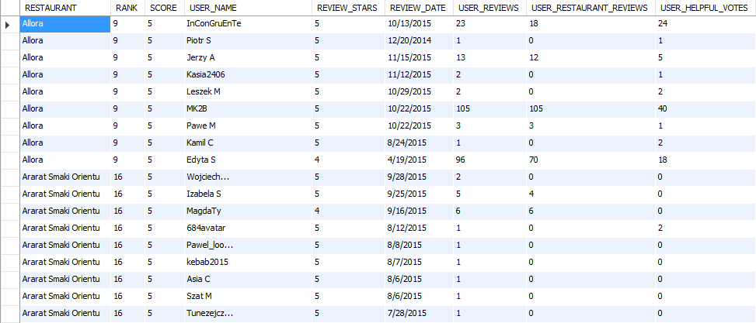
Interesting case: Allora vs Ararat Smaki Orientu
select * from TRIPADVISOR where RESTAURANT = 'Allora' or RESTAURANT = 'Ararat Smaki Orientu';
Same, SCORE, AvgStars, NumReviews
Very different ranking (9 vs 16)
Where’s the difference?
The total number of user reviews, (19 vs 233)
Ratio of helpful votes/total reviews
Allora: 40.17%
Ararat: 10.52%

Slide 6
Possible? Findings
Every factor has a weighting to it
SCORE ranks relatively low
Larger sample size (NumReviews) = more robust data = better ranking?
Helpful reviews ratio:
Lots of low review count but high ranking -> less accurate, “hype” (or even fake!) reviews

